Slide 1
MadLibs.
Design Problem 3

Slide 2
Agenda
Problem Background
Learning Objectives
Coding

Slide 3
Background
MadLibs is a game where you write a story with missing words, then ask someone else to fill in the blanks!
Since they don’t know what your story is about, the result is often wonderful and silly.
Traditionally MadLibs is done with paper and ink, but we are in the digital age!
Goal: Write a Python program that uses string methods and user input to play MadLibs with the user, and output the created story at the end.

Slide 4
Background
Groom’s Name:
Bride’s Name:
Noun:
Number:
School:
Place on Campus:
Verb (-ing):
Verb (-ed):
Greeting:
Adjective:

Slide 5

Background
Groom’s Name:
Bride’s Name:
Noun:
Number:
School:
Place on Campus:
Verb (-ing):
Verb (-ed):
Greeting:
Adjective:

Slide 6
What whimsical stories will you write…

Slide 7
Learning Objectives
Practice working with strings and using string methods.
Practice with user input.
Practice creating custom functions.

Slide 8
Engineering Design Process
Learn to define the problem.
Practice defining test cases.
Develop an algorithm plan (i.e. a workflow!).
Program your solution and debugging.

Slide 9
Some reminders.

Slide 10
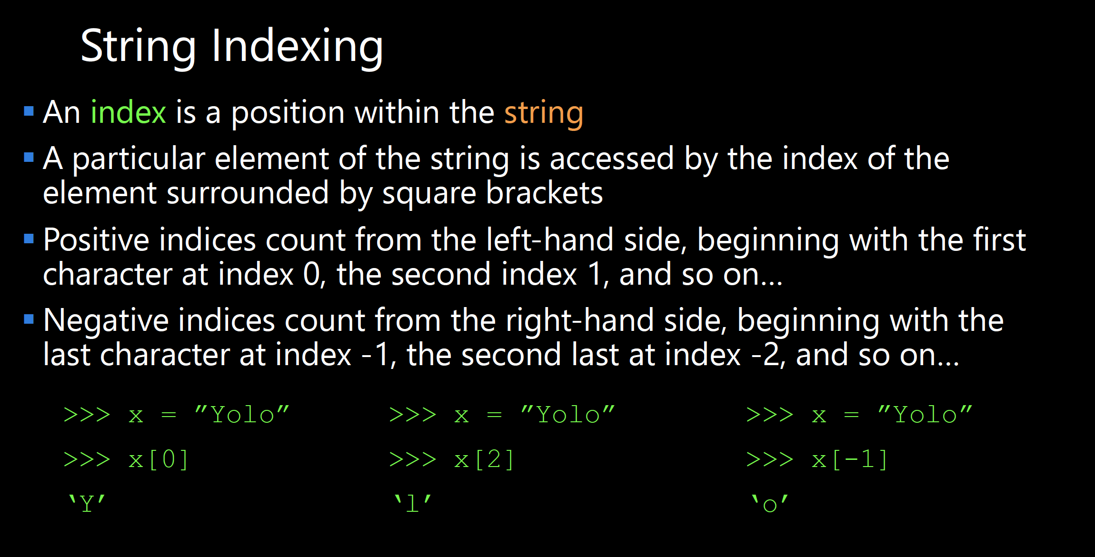

Slide 11
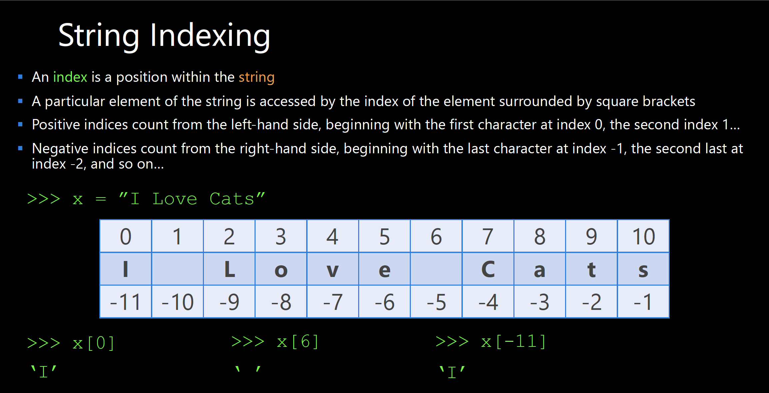

Slide 12
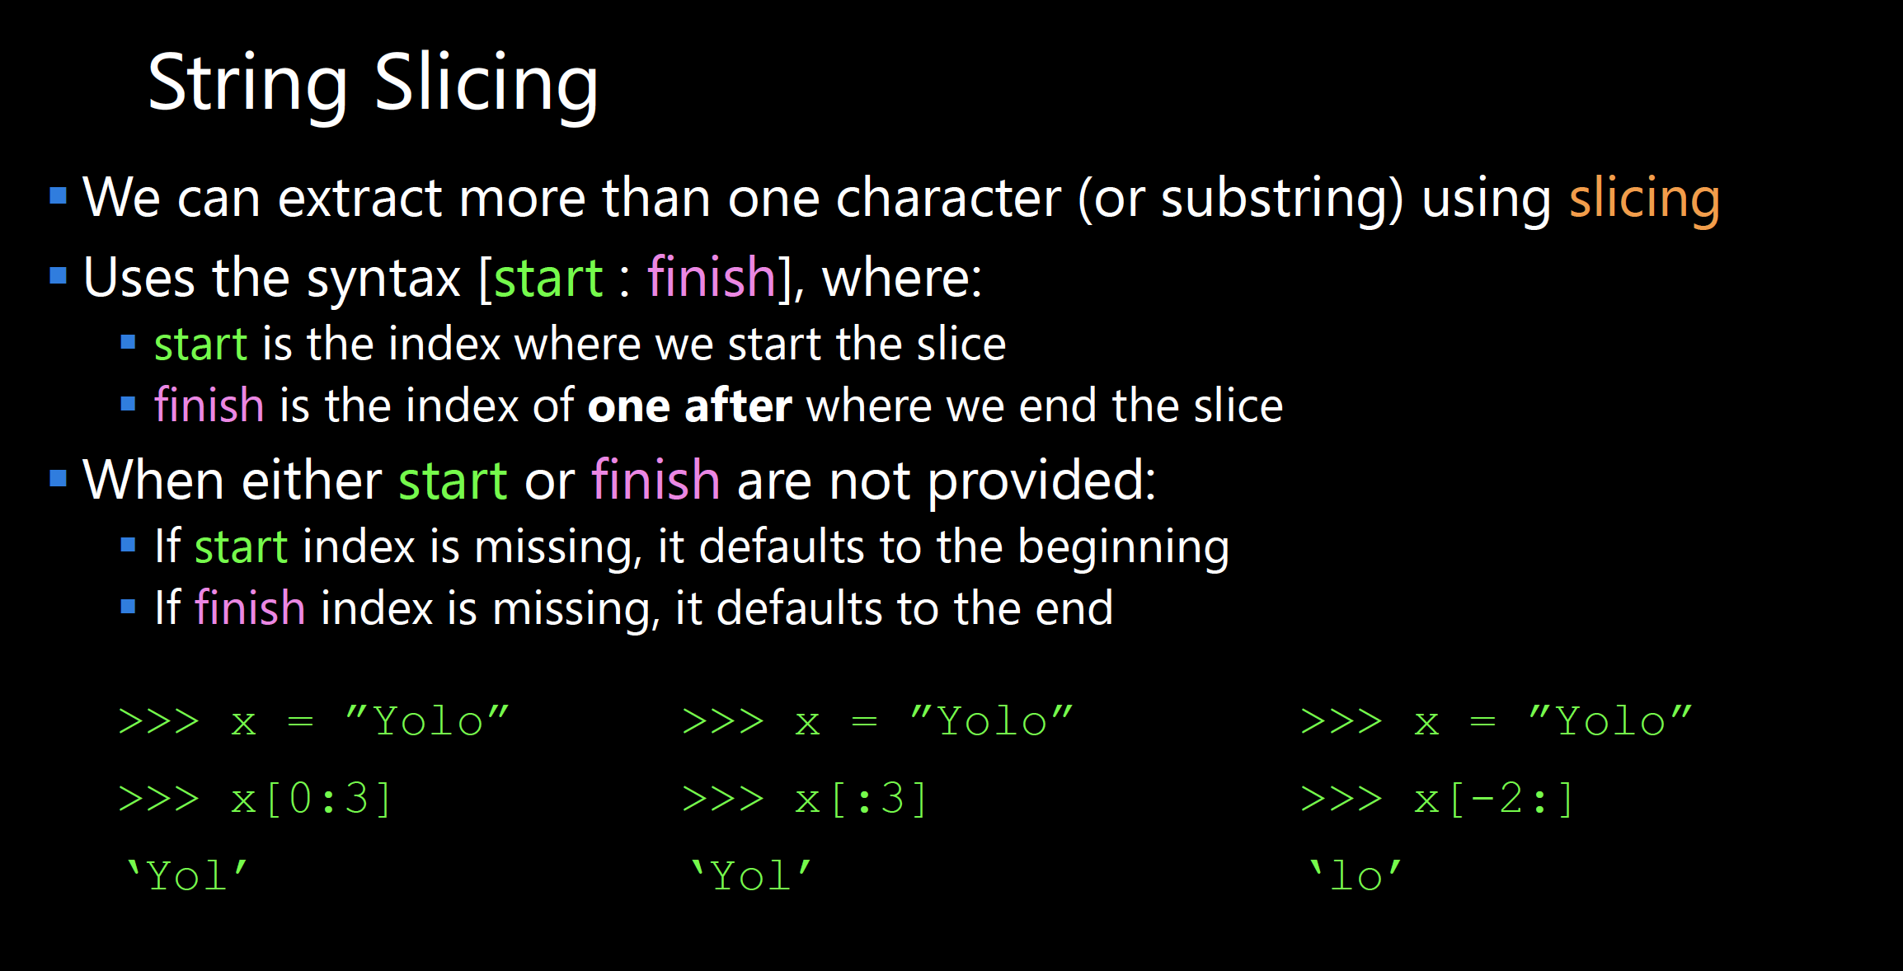

Slide 13
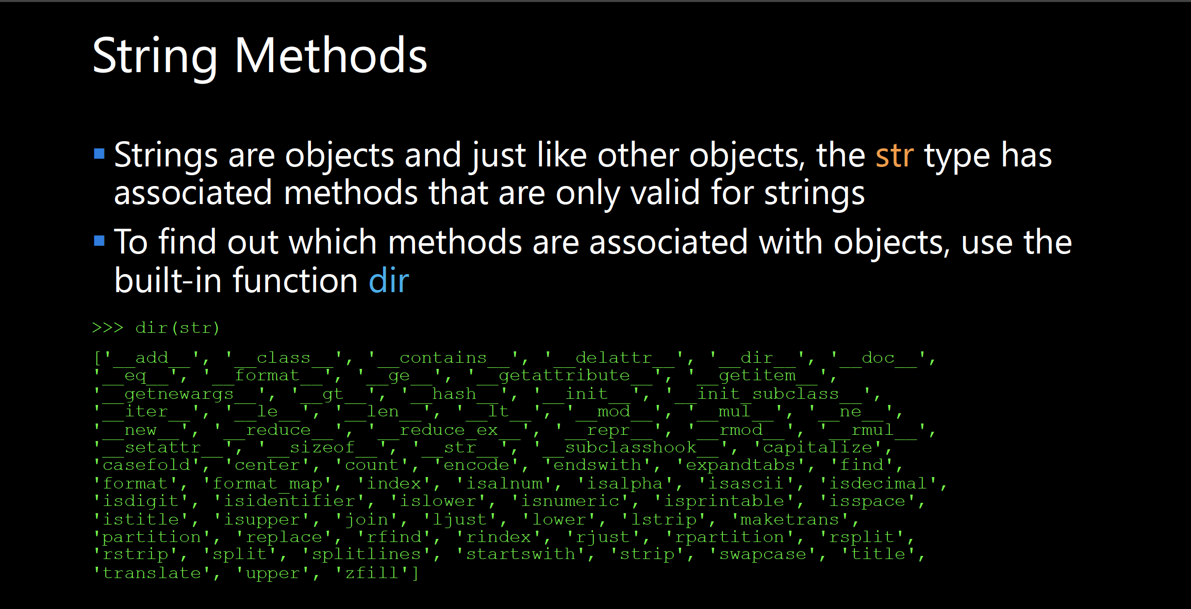

Slide 14
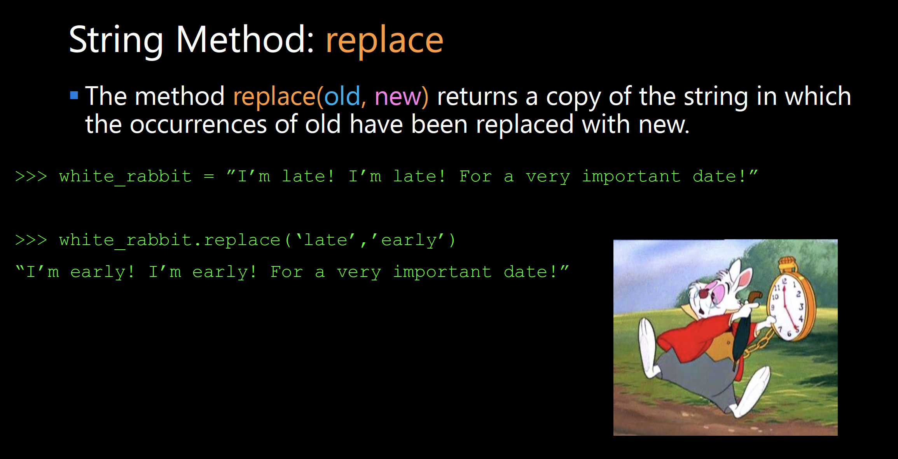

Slide 15
Function Definitions
Definition
Function Name
Colon
def function_body(parameters):
body
Indent
(parameter1,
parameter2, …)
What is in the body?

Slide 16
Function Definitions
def function_body(parameters):
1. “““DOCSTRING””” (optional)
2. Code the does the thing
3. return [expression]
The return statement is options and if it is not included, it’s the same as writing return None

Slide 17
Calling Functions
In Python names of variables and functions use low case and underscores.
function_name
Function_Name
FunctionName
The general form of a function call:
Terminology
argument: a value given to a function.
pass: to provide an argument to a function.
call: ask Python to execute a function (by name).
return: give a value back to where the function was called from.
function_name(arguments)

Slide 18
Input
Python has a built-in function named input for reading text from the user.
The general form of a input function call:
The argument is the text you want displayed to the user.
“What is your name?”
The value returned by the input function is always a string.
input(argument)

Slide 19
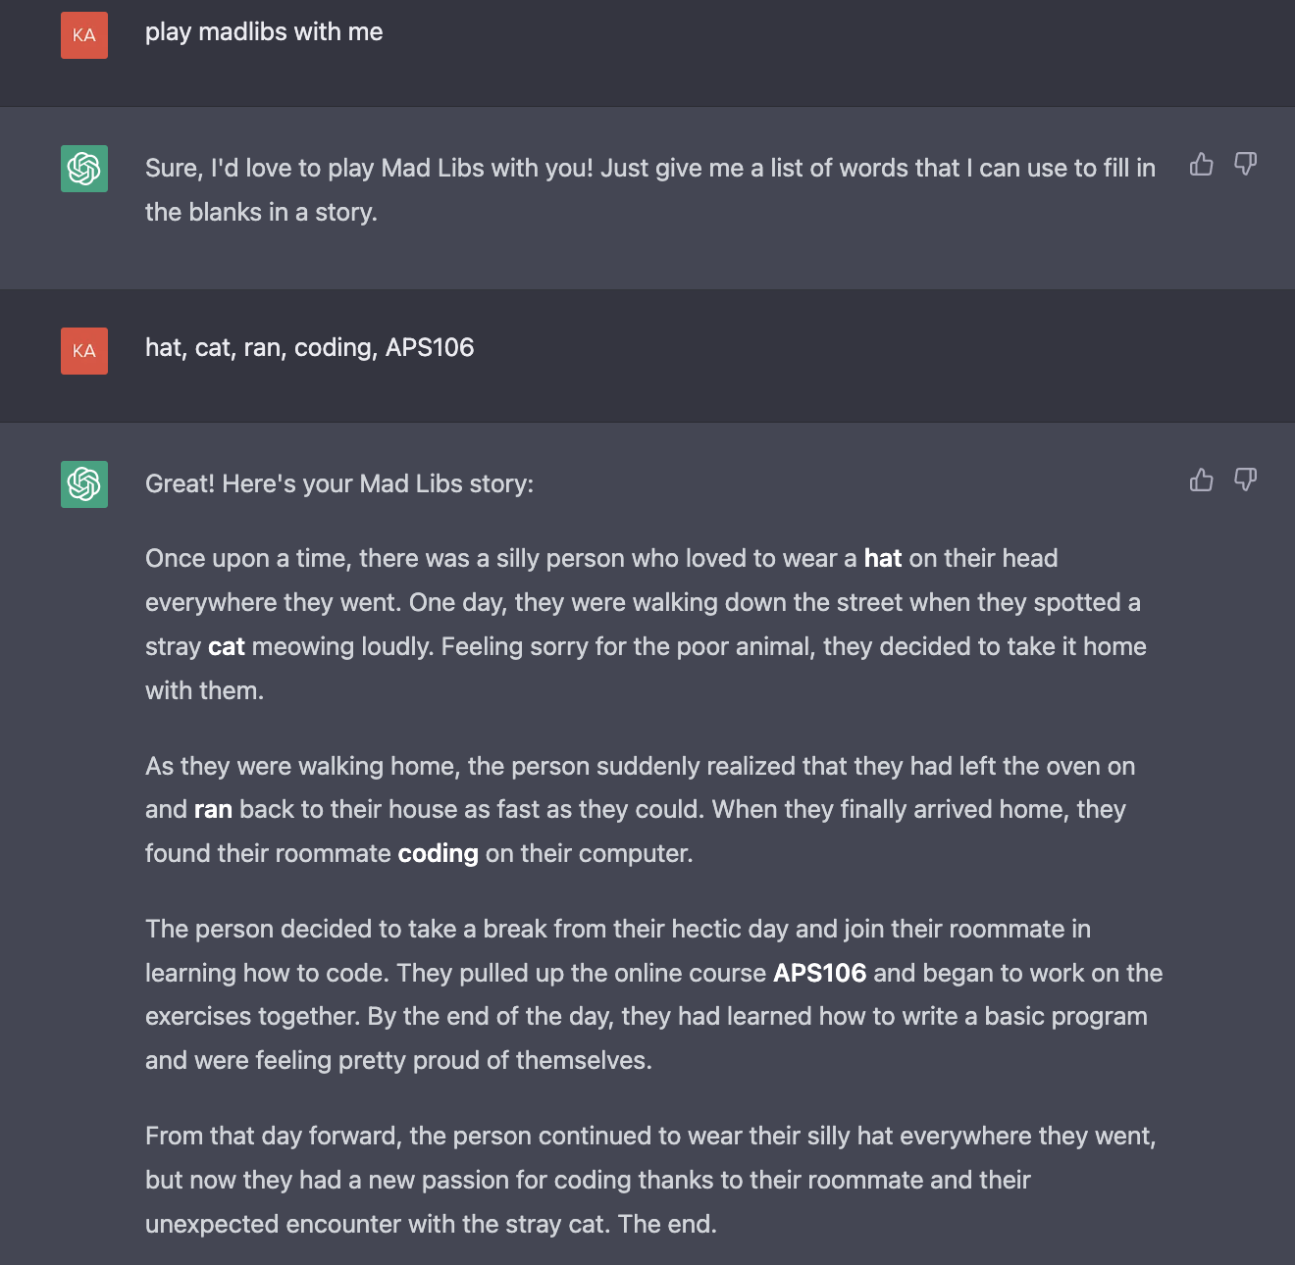
ChatGPT Strikes Again ⚡

Slide 20
MadLibs.
Design Problem 3

